Slide 1

P peline
The Data
Announcements
© Jennifer Mankoff
The Data Pipeline; HCII; Spring 2014

Slide 2
Sign up for meetings!
http://tinyurl.com/km3j45d
Next Tuesday, 9-1.

Slide 3
Review of last lecture
What does a z score mean?

Slide 4
Review of last lecture
What does a z score mean?
It tests how good your sample is (how many standard deviations from the population mean the sample mean is)

Slide 5
Review of last lecture
What does a z score mean?
What does a t statistic mean?
where:

Slide 6
Review of last lecture
What does a z score mean?
What does a t statistic mean?
where:
It is an estimated z score (based on an estimated pop mean)

Slide 7
Review of last lecture
What does a z score mean?
What does a t statistic mean?
where:
One use of t is to compare to the critical value t_{α} (look up α and N-1 to get this)
→ Lets us accept or reject H₀ if t > t_{α}

Slide 8
Review of last lecture
What does a z score mean?
What does a t statistic mean?
where:
If we solve for μ
This is just the formula for calculating the confidence interval

Slide 9
Review of last lecture
What does a z score mean?
What does a t statistic mean?
where:
How do we compare two samples?
The square root was missing yesterday. I fixed it in ALL the slides.

Slide 10
Careful with p values
Does not tell us the likelihood something is true. It only lets us reject or accept a hyp.
Gives a yes or no answer: Either the null hypothesis is rejected (the result would be unlikely [defined by α] in a world where the null hypothesis was true) or it cannot be rejected
false negatives: increase α to reduce these
false positives: reduce α to reduce these

Slide 11
Correlation & Regression
Example scatter plot and regression line
Slope
= 0.10977
Intercept
= 98.248
Adapted from http://www.fordham.edu/economics/Vinod/correl-regr.ppt
Notes:
Here, no houses had 0 square feet, so b₀ = 98.24833 just indicates that, for houses within the range of sizes observed, $98,248.33 is the portion of the house price not explained by square feet

Slide 12
Explained and Unexplained Variation
(continued)
y
y_{i}
∧
∧
SSE = ∑(y_{i} - y_{i} )²
y
_
SST = ∑(y_{i} - y)²
∧
y
_
∧
_
SSR = ∑(y_{i} - y)²
_
y
y
x
X_{i}
Notes:
Sse = sum of squared errors
Sst = total sum of squares
Ssr = regression sum of squares

Slide 13
Correlation vs Regression
Pearson correlation coefficient:
Coefficient of determination (Regression):
after minimizing

Slide 14
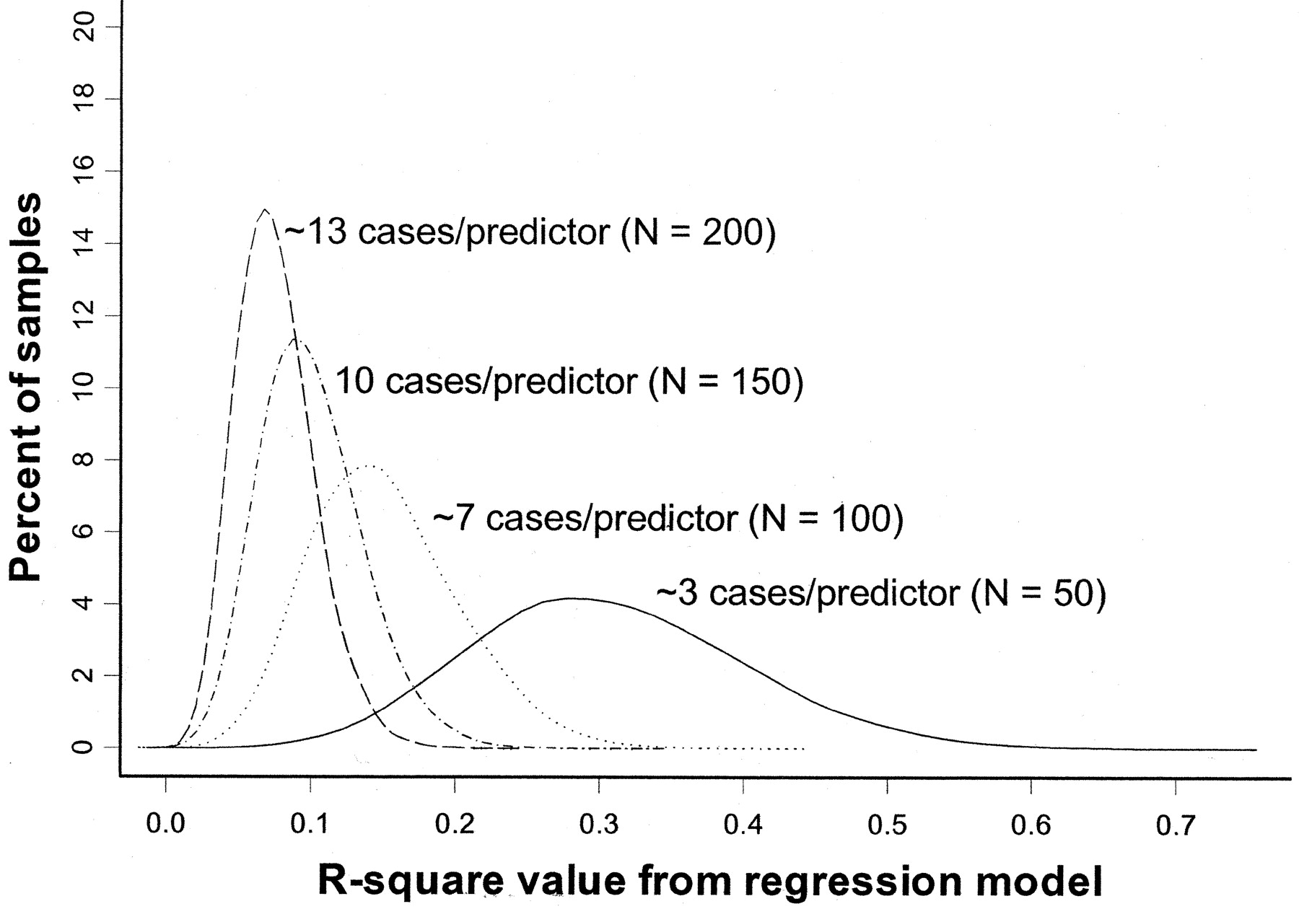
Overfitting simulation (where we know the ‘true’ population has R²=0)
All regression models in simulation have 15 predictors
True R² = 0
(Figure from: Babyak, MA. What You See May Not Be What You Get: A Brief, Nontechnical Introduction to Overfitting in Regression-Type Models. Psychosomatic Medicine 66:411-421 (2004).)
Notes:
The model contained 15 predictors, each consisting of randomly generated values, and a response variable, whose values were also randomly generated

Slide 15
Overfitting: 3 cases/predictor: mean R² looks like .3
R² distribution for 10,000 regressions based on 10,000 random samples of the data (N=50).
(Figure from: Babyak, MA. What You See May Not Be What You Get: A Brief, Nontechnical Introduction to Overfitting in Regression-Type Models. Psychosomatic Medicine 66:411-421 (2004).)
Notes:
Y axis is percent of sample distributions that had a given R2 value (for that N). X axis is distribution of R2 values across the 10,000 regressions (for that N)

Slide 16
Overfitting: 13 cases/predictor: mean R² looks like .05
R² distribution for 10,000 regressions based on 10,000 random samples of the data (N=200)
(Figure from: Babyak, MA. What You See May Not Be What You Get: A Brief, Nontechnical Introduction to Overfitting in Regression-Type Models. Psychosomatic Medicine 66:411-421 (2004).)

Slide 17
Quiz 6

Slide 18
Feedback: Biggest Issues
Thanks for your helpfulness & honesty
Can’t address everything now (or even this year) but a few comments
More examples (many of you)
Notes:
Each year we build up more great examples. Also I pick the best each year and you go further – raising the class bar ☺

Slide 19
Feedback: Biggest Issues
Thanks for your helpfulness & honesty
Can’t address everything now (or even this year) but a few comments
More examples (many of you)
Tutorial difficulties
Notes:
Will take into account and consider revising. At the same time, they are a bonus (and the reason things can/do move quick). Be grateful!

Slide 20
Feedback: Biggest Issues
Thanks for your helpfulness & honesty
Can’t address everything now (or even this year) but a few comments
More examples (many of you)
Tutorial difficulties
More datasets
Notes:
Please, use more! Don’t let me stop you!

Slide 21
Feedback: Biggest Issues
Thanks for your helpfulness & honesty
Can’t address everything now (or even this year) but a few comments
More examples (many of you)
Tutorial difficulties
More datasets
More time
Notes:
Hopefully change in schedule addressed this for project. Bytes are meant to be quick.

Slide 22
Feedback: Biggest Issues
Thanks for your helpfulness & honesty
Can’t address everything now (or even this year) but a few comments
More examples (many of you)
Tutorial difficulties
More datasets
More time
Big Data
Notes:
We’re getting there. Need to understand small data first!

